Slide 1
Introduction to Network Layer
Reference:
Behrouz A. Forouzan, TCP/IP Protocol Suite, 4th Edition, Tata McGraw Hill, 2010
Notes:
Reference:

Slide 2
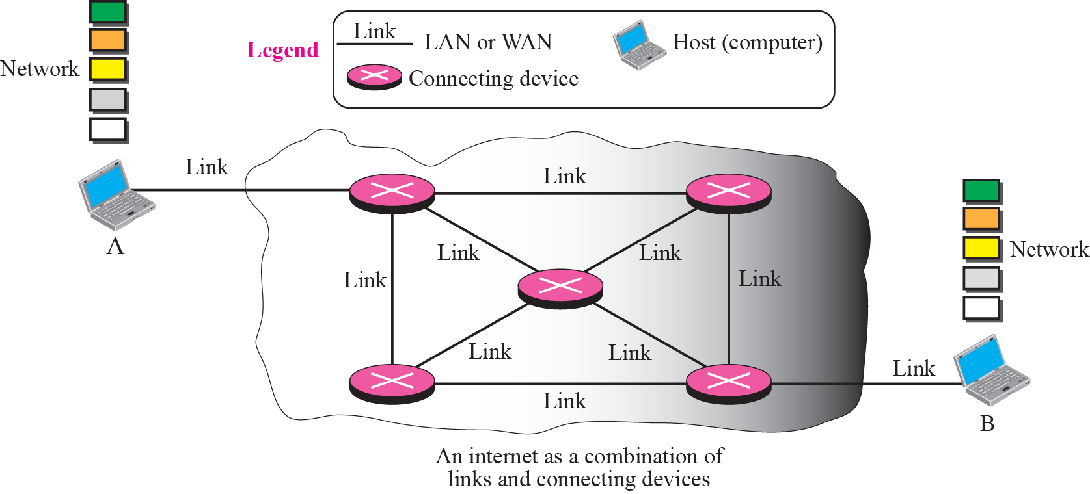
The Internet
-Not one single network
-Made of many networks connected together through the connecting devices.
-So inter-network
An imaginary small internet with a few networks and a few connecting devices
How data flows from A to B ? - Role of Routers. Switching Process
Notes:
The Internet, however, is not one single network; it is made of many networks (or links) connected together through the connecting devices.
In this model, a connecting device such as a router acts as a switch. When a packet arrives from one of its ports (interface), the packet is forwarded through another port to
the next switch (or final destination). In other words, a process called switching occurs at the connecting device.

Slide 3
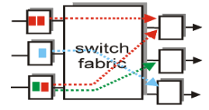
SWITCHING
When a message reaches a connecting device, a decision needs to be made to select one of the output ports through which the packet needs to be send out.
Connecting device acts as a switch that decides & connects one port to another port.
This process is known as - Switching
Notes:
Connection is switched from one port to another port

Slide 4
TYPES OF SWITCHING
Following are the two solutions to achieve Switching.
Circuit Switching
Packet Switching
Notes:
Following are the two ways to achieve Switching.

Slide 5
Circuit Switching
A physical circuit (or channel) is established between the source and destination of the message before the delivery of the message.
-whole message is sent
-no need to divide into smaller chunks or packets
After transmission circuit (or channel) is established is removed.
Example-
A good example of a circuit-switched network is the early telephone systems in which the path was established between a Caller and a Callee when the telephone number of the Callee was dialed by the Caller.
Notes:
One solution to the switching is referred to as circuit switching, in which a physical circuit (or channel) is established between the source and destination of the message before the delivery of the message. After the circuit is established, the entire message,
is transformed from the source to the destination. The source can then inform the network that the transmission is complete, which allows the network to open all switches and use the links and connecting devices for another connection. The circuit
switching was never implemented at the network layer; it is mostly used at the physical layer.
Circuit switched communication, for example the public switched telephone network, ISDN, SONET/SDH and optical mesh networks, are intrinsically connection-oriented communications systems. Circuit mode communication provides guarantees that data will arrive with constant bandwidth and at constant delay and in-order delivery of a bit stream or byte stream is provided. The switches are reconfigured during a circuit establishment phase.

Slide 6
Packet Switching
The network layer in the Internet today is a packet-switched network.
–The message is first divided into manageable chunks or packets at
Source(upper layers) & transmitted.
- The Routers need to decide how to route the packets to the final destination.
- The packets are assembled at the destination.
Today, a packet-switched network can use two approaches-
Datagram Approach -independent path (connectionless)
Virtual Circuit Approach – a fixed path (Connection Oriented)
Notes:
The circuit (or channel) is establishment is not required
The network layer in the Internet today is a packet-switched network. In this type of network, a message from the upper layer is divided into manageable packets and each packet is sent through the network. The source of the message sends the packets one by one; the destination of the message receives the packets one by one. The destination waits for all packets belonging to the same message to arrive before delivering the message to the upper layer. The connecting devices in a packet-switching network still need to decide how to route the packets to the final destination. Today, a packet-switched network can use two different approaches to route the packets: the datagram approach and the virtual circuit.

Slide 7
PACKET SWITCHING…
Datagram Approach
–The manageable chunks or packets are called as Datagrams
- - The packet-switched network layer of the Internet was designed as-
Connectionless Service but tendency is towards Connection oriented
Notes:
The network layer is designed as a packet-switched network. This means that the
packet at the source is divided into manageable packets, normally called datagrams.
Individual datagrams are then transferred from the source to the destination. The
received datagrams are assembled at the destination before recreating the original message.
The packet-switched network layer of the Internet was originally designed as a
connectionless service, but recently there is a tendency to change this to a connectionoriented
service.

Slide 8
PACKET SWITCHING…
Connectionless Service
–The manageable chunks or packets are called as Datagrams
– The network layer protocol treats each packet independently.
– Each packet has no relationship to any other packet.
– Datagram of a message may or may not travel the same path.
– Initially to keep design simple, Internet was decided to make Connectionless Service
Notes:
When the network layer provides a connectionless service, each packet traveling in
the Internet is an independent entity; there is no relationship between packets belonging
to the same message. The switches in this type of network are called routers.
A packet belonging to a message may be followed by a packet belonging to the same message or
a different message. A packet may be followed by a packet coming from the same or
from a different source.
Each packet is routed based on the information contained in its header: source and
destination address.

Slide 9
PACKET SWITCHING…
Forwarding process in connectionless Service Network
The packet contained in its header: source, destination address & other information.
Packet routing is based on the destination address.
Notes:
Each packet is routed based on the information contained in its header: source and
destination address. The destination address defines where it should go; the source
address defines where it comes from. The router in this case routes the packet based
only on the destination address. The source address may be used to send an error message
to the source if the packet is discarded. Figure shows the forwarding process in
a router in this case. We have used symbolic addresses such as A and B.

Slide 10
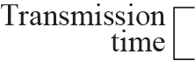
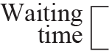
PACKET SWITCHING…
Delay in Connection less Network
Notes:
Delay In Connectionless Network
If we ignore the fact that the packet may be lost and resent and also the fact that the destination
may be needed to wait to receive all packets, we can model the delay as shown
in Figure

Slide 11
PACKET SWITCHING…
Connection Oriented Service
–The manageable chunks or packets are called as Datagrams
–There is a relation between all packets belonging to a message.
–A virtual connection should be set up to define the path for the datagrams.
Packet contains-
Source , Destination Address also
flow label(Virtual Circuit identifier- VCI)
VCI determines path through which packet must pass through.
Is only VCI enough ?
Is still Source, Destination addresses required?
Notes:
In version IP6, the flow label has been directly added to the format of the IPv6 datagram to allow us to use IPv6 as connection-oriented protocol.(chapter 27 IPv6 page789)
To a router, a flow is a sequence of packets that share the same characteristics, such as traveling the same path, using the same resources, having the same kind of security,
and so on. A router that supports the handling of flow labels has a flow label table.
After connection setup, the datagrams can follow the same path. In this type of service, not only must the packet contain the source and destination addresses, it must also contain a flow label, a virtual circuit identifier that defines the virtual path the packet should follow.
When requesting a connection-oriented service in these networks, at the connection setup time the user specifies the QoS that is required by the user application. The network can then determine whether it has sufficient resources available to handle that connection with the requested QoS, and the network can then set aside these resources for the connection. In order to undertake these tasks, the network retains “state” information about existing connections.
Is only VCI enough ? Why still Source, Destination addresses required.
Although it looks as though the use of the label may make the source and destination addresses useless, one reason is that-the parts of the Internet that use connectionless service at the network layer still keep these addresses for several reasons. One reason is that part of the packet path may still be using the connectionless service. Another reason is that the protocol at the network layer is designed with these addresses and it may take a while before they can be changed.
Transport layer connection mode communication.
Connection-oriented transport layer protocols provide connection-oriented communications over connectionless communications systems. A connection-oriented transport layer protocol, such as TCP, may be based on a connectionless network layer protocol (such as IP), but still achieves in-order delivery of a byte-stream, by means of segment sequence numbering on the sender side, packet buffering and data packet reordering on the receiver side. The sequence numbering requires two-way synchronization of segment counters during a three-step connection establishment phase.
Datalink and network layer virtual circuit switching
In a connection-oriented packet switched data link layer or network layer protocol, all data is sent over the same path during a communication session. The protocol identifies traffic flows only by a channel/data stream number, often denoted virtual circuit identifier (VCI), rather than by complete routing information for each packet (source and destination addresses) used in connectionless datagram switching such as conventional IP routers. In connection-oriented communication, routing information may be provided to the network nodes during the connection establishment phase, where the VCI is defined in tables in each node. Thus, the actual packet switching and data transfer can be taken care of by fast hardware, as opposed to slow software based routing. Typically, this connection identifier is a small integer (10 bits for Frame Relay, 24 bits for ATM, for example). This makes network switches substantially faster (as routing tables are just simple look-up tables, and are trivial to implement in hardware). The impact is so great, in fact, that even characteristically connectionless protocols, such as IP traffic, are being tagged with connection-oriented header prefixes (e.g., as with MPLS, or IPv6's built-in Flow ID field^{[citation needed]}).
ATM and Frame Relay, for example, are both examples of a connection-oriented, unreliable data link layer protocols. There are also reliable connectionless protocols as well, such as AX.25 network layer protocol
VCI determines path through which packet must pass through.

Slide 12
PACKET SWITCHING…
Forwarding process in a connection-oriented network
How Labels entries are made into the Routing table ?
Notes:
To create a connection-oriented service, a three-phase process is used: setup, data
transfer, and teardown. In the setup phase, the source and destination addresses of the
sender and receiver is used to make table entries for the connection-oriented service. In
the teardown phase, the source and destination inform the router to delete the corresponding
entries. Data transfer occurs between these two phases.

Slide 13
PACKET SWITCHING…
Virtual Circuits -
A three-phase process is used: setup, data transfer, and teardown
Setup Phase uses two auxiliary packets named – Request & Acknowledgement packets.
Sending Request packet
Notes:
To create a connection-oriented service, a three-phase process is used: setup, data transfer, and teardown. In the setup phase, the source and destination addresses of the
sender and receiver is used to make table entries for the connection-oriented service. In the teardown phase, the source and destination inform the router to delete the corresponding entries. Data transfer occurs between these two phases.

Slide 14
PACKET SWITCHING…
Virtual Circuits -
Setup Phase uses two auxiliary packets named – Request & Acknowledgement packets.
Setup Acknowledgment Packet
Notes:
Setup Phase
In the setup phase, a router creates an entry for a virtual circuit. For example, suppose
source A needs to create a virtual circuit to destination B. Two auxiliary packets need to
be exchanged between the sender and the receiver: the request packet and the acknowledgment packet.
Request packet A request packet is sent from the source to the destination. This auxiliary
packet carries the source and destination addresses. Figure 4.8 shows the process.
1. Source A sends a request packet to router R1.
2. Router R1 receives the request packet. It knows that a packet going from A to B
goes out through port 3. Signaling protocols such as RSVP Resource Reservation Protocol (RSVP) as a signalling
protocol that helps IP create a flow and makes a resource reservation.
For the moment, assume that it knows the output port.
The router creates an entry in its table for this virtual circuit, but it is only able to fill three of the four columns. The router assigns the incoming port (1) and chooses
an available incoming label (14) and the outgoing port (3). It does not yet know the outgoing label, which will be found during the acknowledgment step. The router
then forwards the packet through port 3 to router R3.
3. Router R3 receives the setup request packet. The same events happen here as at
router R1; three columns of the table are completed: in this case, incoming port
(1), incoming label (66), and outgoing port (2).
4. Router R4 receives the setup request packet. Again, three columns are completed:
incoming port (2), incoming label (22), and outgoing port (3).
5. Destination B receives the setup packet, and if it is ready to receive packets from A, it
assigns a label to the incoming packets that come from A, in this case 77. This
label lets the destination know that the packets come from A, and not other
sources.

Slide 15
PACKET SWITCHING…
Virtual Circuits -
Data Transfer phase
Flow of one packet in an established virtual circuit

Slide 16
PACKET SWITCHING…
Virtual Circuits -
Teardown Phase
After sending all packets from A to B
A sends a special packet called a teardown packet.
Destination B responds with a confirmation packet.
All routers delete the corresponding entry from their tables.
Notes:
Permanent (Permanent Virtual Circuit (PVC)) ,﻿ i.e., circuits permanently built by the network administrator.
Switched (Switched Virtual Circuit (SVC)), i.e., virtual circuits that are created dynamically as the need arises. An SVC is created with the help of signalizing protocols that can be used for communicating between the user and the network itself. The network signalizes to the user various events that can be used for network monitoring and administration. SVC communication consists of two steps: creating the virtual circuit and using it for communication.

Slide 17
PACKET SWITCHING…
Delay in Connection Oriented Network
Notes:
Permanent (Permanent Virtual Circuit (PVC)) ,﻿ i.e., circuits permanently built by the network administrator.
Switched (Switched Virtual Circuit (SVC)), i.e., virtual circuits that are created dynamically as the need arises. An SVC is created with the help of signalizing protocols that can be used for communicating between the user and the network itself. The network signalizes to the user various events that can be used for network monitoring and administration. SVC communication consists of two steps: creating the virtual circuit and using it for communication.

Slide 18
NETWORK LAYER SERVICES
What are the services provided by the network layer ?
Our discussion will be based on the connectionless service, the dominant service in today’s Internet.
Multiprotocol Label Switching (MPLS) is a routing technique in telecommunications networks that directs data from one node to the next based on short path labels rather than long network addresses(IP).
IPv6 is being introduced to overcome the address shortage of the current IPv4 protocol, but it also offers a new feature, i.e., the Flow Label field in the IPv6 packet header. However, it is used very little in practice
Notes:
Permanent (Permanent Virtual Circuit (PVC)) ,﻿ i.e., circuits permanently built by the network administrator.
Switched (Switched Virtual Circuit (SVC)), i.e., virtual circuits that are created dynamically as the need arises. An SVC is created with the help of signalizing protocols that can be used for communicating between the user and the network itself. The network signalizes to the user various events that can be used for network monitoring and administration. SVC communication consists of two steps: creating the virtual circuit and using it for communication.
Protocols using virtual circuits are called Connection-Oriented Network Services (CONS) and protocols transporting their packets without using virtual circuits are called Connection-Less Network Services (CLNS)

Slide 19
NETWORK LAYER SERVICES
Why Network Layer ?

Slide 20
NETWORK LAYER SERVICES
Services provided.
Logical Addressing
Services Provided at the Source Computer
Services Provides at the Each Router
Services Provided at the Destination Computer

Slide 21
NETWORK LAYER SERVICES
Imaginary part of the Internet & TCP/IP Layers
The two computers are involved in five layers;
The routers are involved in three layers of the TCP/IP protocol suite.

Slide 22
NETWORK LAYER SERVICES
Logical Addressing
–The network layer provides end-to-end communication.
– Each system in the network needs universal identification system(Logical Address/ Network Layer Address).
– IPv4 is the addressing scheme used( 32 bit address)
– New one is IPv6 addressing scheme
Notes:
https://www.ibm.com/docs/en/zos/2.3.0?topic=guide-overview-internetworking

Slide 23
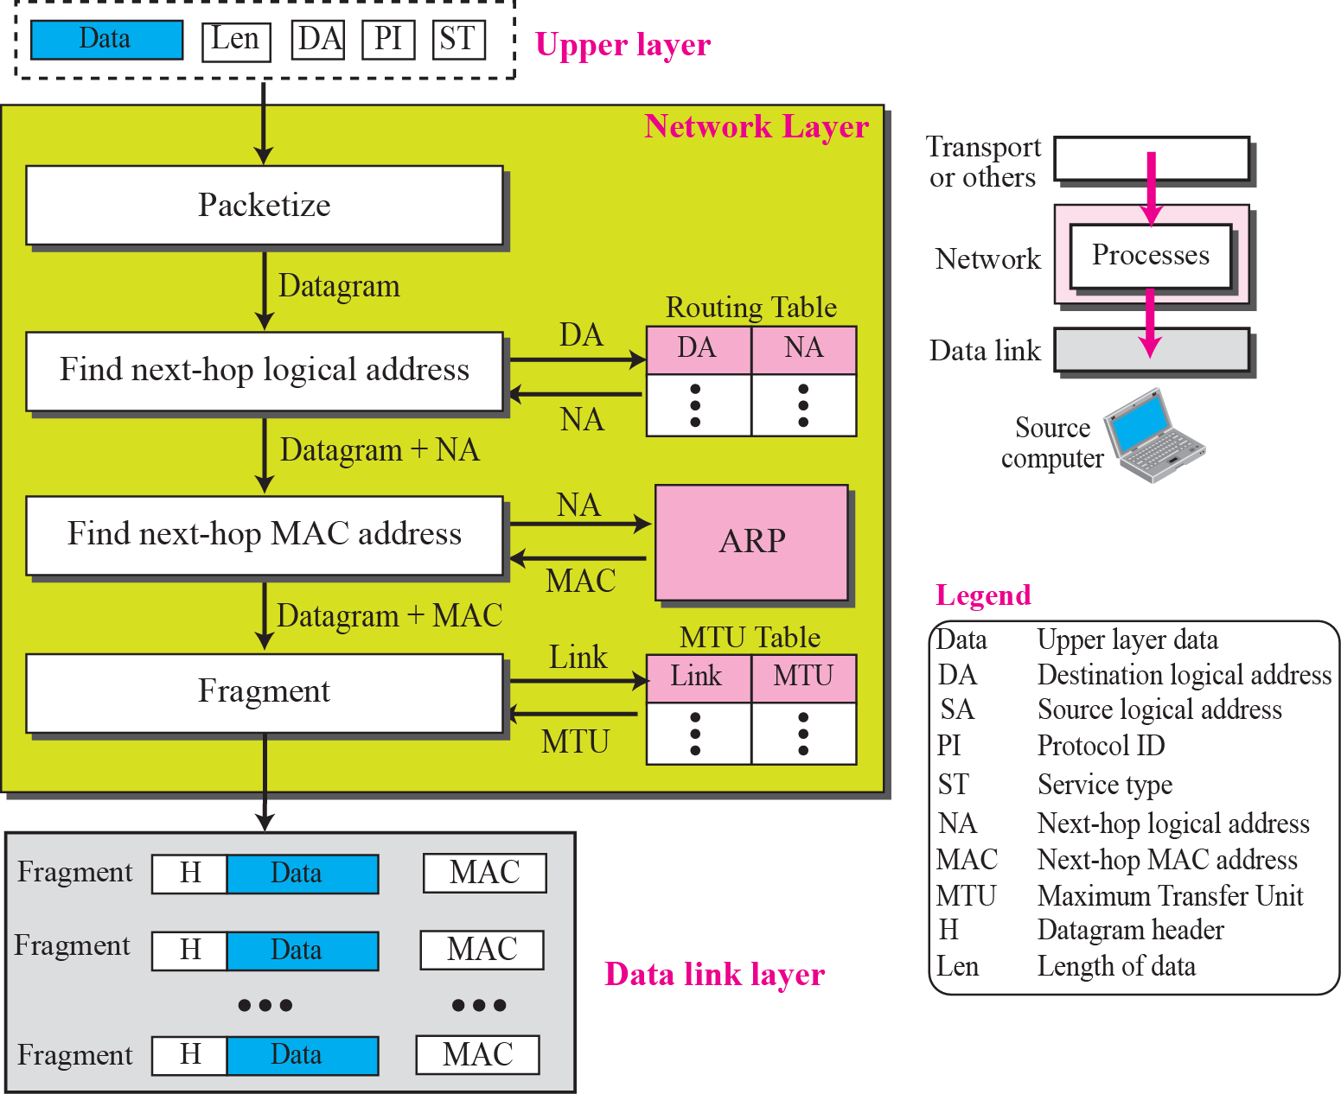
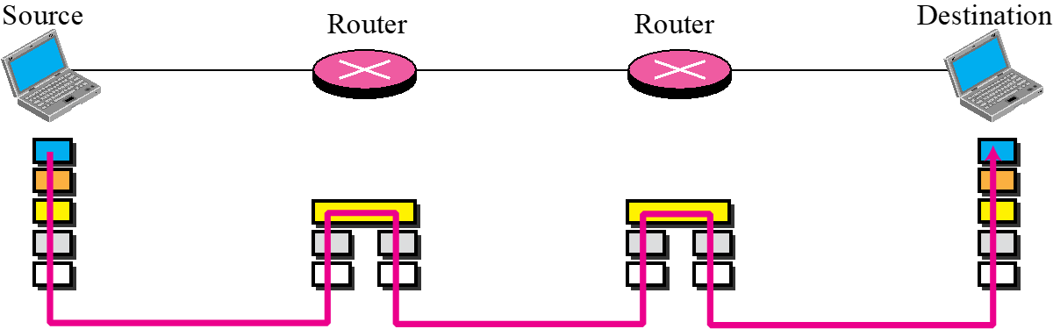
NETWORK LAYER SERVICES
Services Provided at the Source Computer
The network layer at the source computer provides 4 services:
Packetizing
Finding the logical address of the next hop
Finding the physical (MAC) address of the next hop
Fragmenting, the datagram if necessary.
Notes:
The Maximum Transmission Unit (MTU) is the largest size of IP datagram which may be transferred using a specific data link connection The MTU value is a design parameter of a LAN and is a mutually agreed value (i.e. both ends of a link agree to use the same specific value) for most WAN links.
The size of MTU may vary greatly between different links (e.g. typically from 128 B up to 10 kB).The prevalent Path MTU on the Internet is now 1500 bytes, the Ethernet MTU. There are some initiatives to support larger MTUs in networks (e.g. 8 KB), in particular on research networks
MTU-(https://www.ibm.com/docs/en/zos/2.3.0?topic=internetworking-maximum-transmission-unit-mtu) Different physical networks have different maximum frame sizes. Within the different frames, there is a maximum size for the data field. This value is called the maximum transmission unit (MTU), or maximum packet size in TCP/IP terms.
In networking, maximum transmission unit (MTU) is a measurement representing the largest data packet that a network-connected device will accept. Imagine it as being like a height limit for freeway underpasses or tunnels: Cars and trucks that exceed the height limit cannot fit through, just as packets that exceed the MTU of a network cannot pass through that network.
The data packets that exceed MTU are broken up into smaller pieces so that they can fit through. This process is called fragmentation. Fragmented packets are reassembled once they reach their destination.
The network layer at the source computer provides 4 services:
Packetizing
The first duty of the network layer is to encapsulate the data coming from the upper layer in a datagram. This is done by adding a header to the data that contains the logical source and destination address of the packet, information about fragmentation, the protocol ID of the protocol that has requested the service, the data length, and possibly some options. The network layer also includes a checksum that is calculated only over the datagram header.
Finding Logical Address of Next Hop
The prepared datagram contains the source and destination addresses of the packet. The datagram, as we saw before, may have to pass through many networks to reach its final destination. If the destination computer is not connected to the same network as the source, the datagram should be delivered to the next router. The source and destination address in the datagram does not tell anything about the logical address of the next hop. The network layer at the source computer needs to consult a routing table to find the logical address of the next hop.
Finding MAC Address of Next Hop
The network layer does not actually deliver the datagram to the next hop; it is the duty of the data link layer to do the delivery. The data link layer needs the MAC address of
the next hop to do the delivery. To find the MAC address of the next hop, the network layer could use another table to map the next-hop logical address to the MAC address. However, for the reason we discuss in Chapter 8, this task has been assigned to another auxiliary protocol called Address Resolution Protocol (ARP) that finds the MAC address of the next hop given the logical address.
Fragmentation
The datagram at this step may not be ready to be passed to the data link layer. As we saw in Chapter 3, most LANs and WANs have a limit on the size of the data to be carried in a frame (MTU). The datagram prepared at the network layer, may be larger than that limit. The datagram needs to be fragmented to smaller units before being passed to the data link layer. Fragmentation needs to preserve the information at the header of the datagram. In other words, although the data can be fragmented, the header needs to be repeated. In addition, some more information needs to be added to the header to define the position of the fragment in the whole datagram.
https://erg.abdn.ac.uk/users/gorry/course/inet-pages/mtu.html
Example calculation of the segmentation performed by IP Routers
"Calculate the number of fragments which are sent when an IP datagram with payload of 3000 bytes is sent from a computer on a network A via two routers to a destination computer C. The MTU if network A is 4000 B. The MTU of network B is 508 B and for network C the MTU is 1500 B. Ensure that your answer specifies the number and size the of the IP datagrams sent on each of the LANs."
On First LAN
Total size of initial PDU = 3000 + 20 B (PCI) = 3020 B.
Network A: MTU 4000 B > 3020 B - therefore one packet is sent.
(packet sent with offset=0, more=FALSE)
On Second LAN
Network B: MTU 508 B < 3020 B - therefore fragmentation is required.
IP fragment payload size = 508- 20 B = 488 B. (Note this is aligned to an 8-byte boundary)
Total number of packets sent via network B = round(3000/488) = 7 packets.
First six packets of size 508 B, each with 488B of IP packet payload
The last packet has 48 B of data, and therefore of size 20 B + 72 B=92 B.
(all packets except first sent with offset>0,)
(packets 1-6 have more=TRUE, last packet has more=FALSE)
(This last fragment does not need to have a length that is divisible by 8).
On Final LAN
Fragments are not reassembled by a router - i.e. at router C.
Router C therefore receives 7 packets, 6 of size 508 B, 1 of size 92 B.
Network C: MTU 1500 B > 508 B - No further fragmentation is therefore needed.
i.e. There are 7 packets, as in network C, 6 of size 508 B and one of size 92 B.

Slide 24
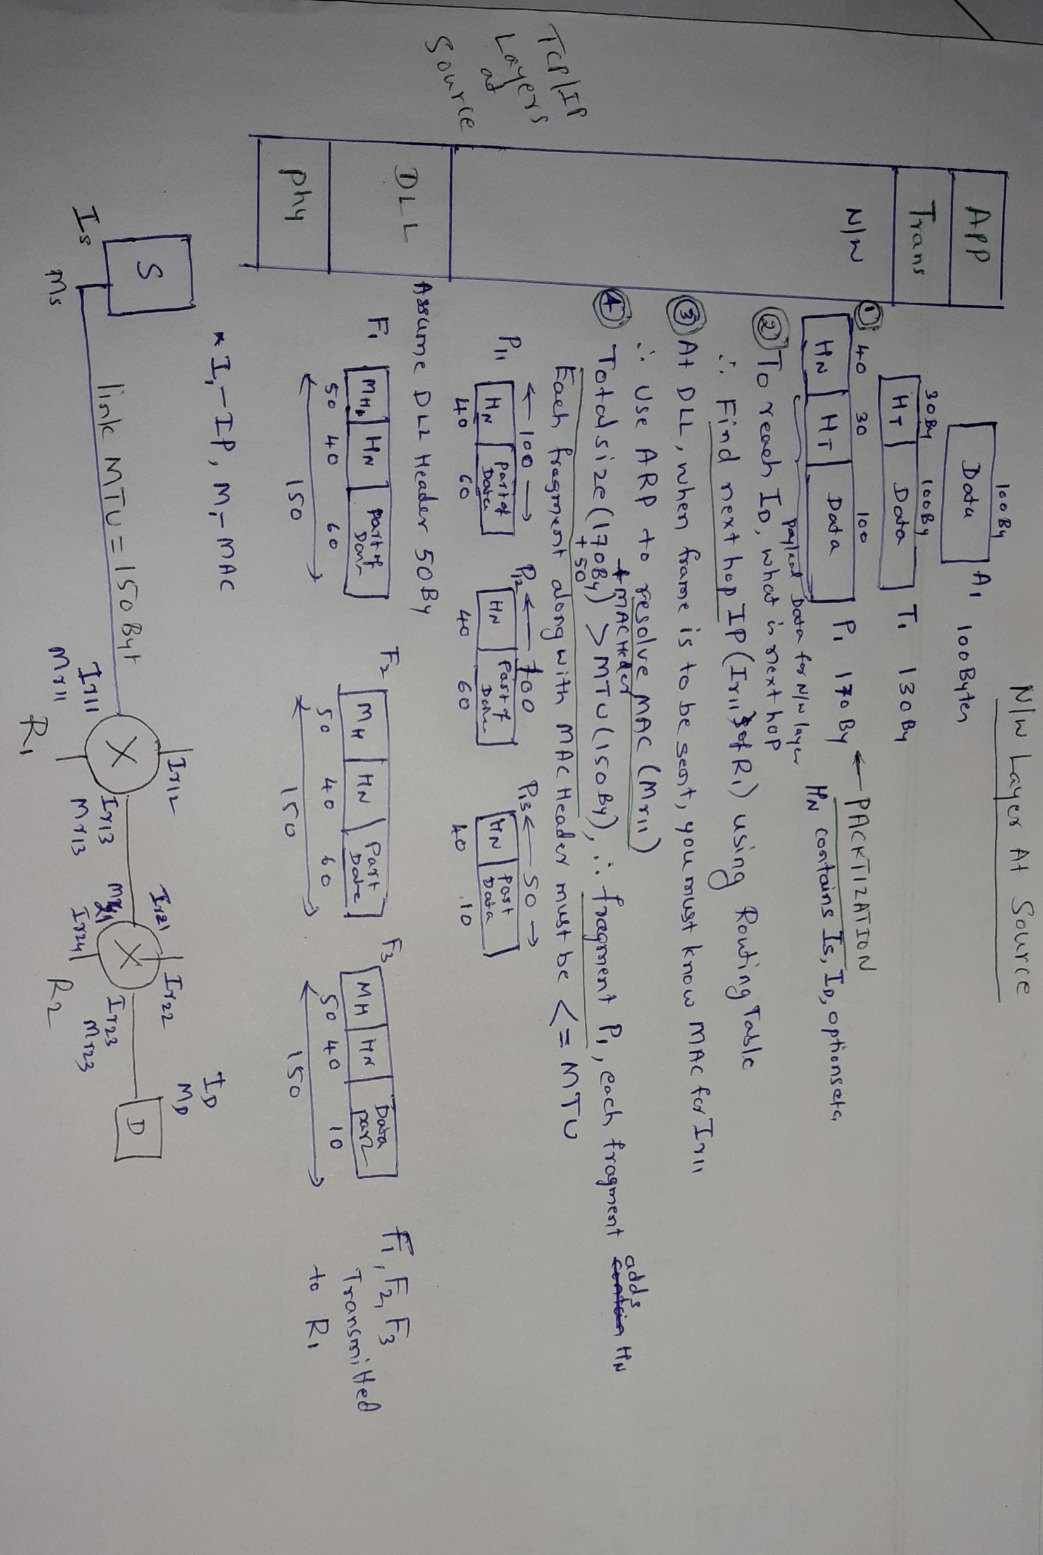
Network Layer at Source Computer
Notes:
https://erg.abdn.ac.uk/users/gorry/course/inet-pages/mtu.html
Example calculation of the segmentation performed by IP Routers
"Calculate the number of fragments which are sent when an IP datagram with payload of 3000 bytes is sent from a computer on a network A via two routers to a destination computer C. The MTU if network A is 4000 B. The MTU of network B is 508 B and for network C the MTU is 1500 B. Ensure that your answer specifies the number and size the of the IP datagrams sent on each of the LANs."
On First LAN
Total size of initial PDU = 3000 + 20 B (PCI) = 3020 B.
Network A: MTU 4000 B > 3020 B - therefore one packet is sent.
(packet sent with offset=0, more=FALSE)
On Second LAN
Network B: MTU 508 B < 3020 B - therefore fragmentation is required.
IP fragment payload size = 508- 20 B = 488 B. (Note this is aligned to an 8-byte boundary)
Total number of packets sent via network B = round(3000/488) = 7 packets.
First six packets of size 508 B, each with 488B of IP packet payload
The last packet has 48 B of data, and therefore of size 20 B + 72 B=92 B.
(all packets except first sent with offset>0,)
(packets 1-6 have more=TRUE, last packet has more=FALSE)
(This last fragment does not need to have a length that is divisible by 8).
On Final LAN
Fragments are not reassembled by a router - i.e. at router C.
Router C therefore receives 7 packets, 6 of size 508 B, 1 of size 92 B.
Network C: MTU 1500 B > 508 B - No further fragmentation is therefore needed.
i.e. There are 7 packets, as in network C, 6 of size 508 B and one of size 92 B.

Slide 25
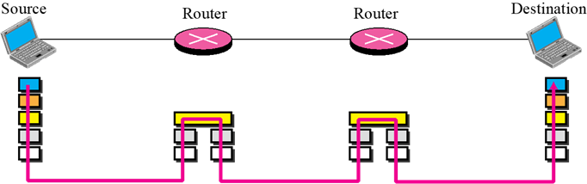
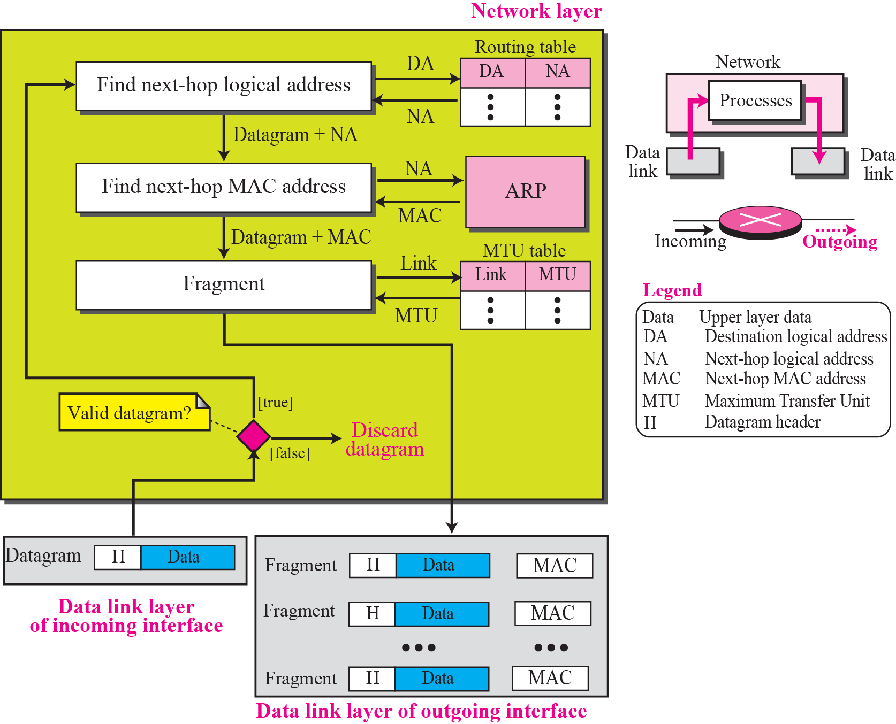
NETWORK LAYER SERVICES
Services Provides at the Each Router
Validates incoming Datagram.
The network layer at the Router provides 3 services:
Finding the logical address of the next hop
Finding the physical (MAC) address of the next hop
Fragmenting, the datagram if necessary.
Recalculates Network Packet header checksum & adds to the header
Router, therefore, needs to interact with two data link layers(DLL)
DLL of incoming interface
DLL of outgoing interface
Notes:
A router is involved with two interfaces with respect to a single datagram: the incoming interface and the outgoing interface. The network layer
at the router, therefore, needs to interact with two data link layers: the data link of the incoming interface and the data link layer of the outgoing interface. The network layer
is responsible to receive a datagram from the data link layer of the incoming interface, fragment it if necessary, and deliver the fragments to the data link of the outgoing interface. The three processes (finding next-hop logical address, finding next-hop MAC address, and fragmentation) here are the same as the last three processes mentioned for a source. Before applying these processes, however, the router needs to check the validity of the datagram using the checksum (see Chapter 7). Validation here means that the datagram header is not corrupted and the datagram is delivered to the correct router.
Some times Router may contain higher layers too such as- It's running a management daemon where you can login to manage the device using higher level protocols (SSH, HTTPS, SNMP, or perhaps even something like NETCONF or a REST API).
Devices that typically support SNMP include cable modems, routers, switches, servers, workstations, printers, and more. ... SNMP is a component of the Internet Protocol Suite as defined by the Internet Engineering Task Force (IETF).
The core of SNMP is a simple set of operations (and the information these operations gather) that gives administrators the ability to change the state of some SNMP-based device. For example, you can use SNMP to shut down an interface on your router or check the speed at which your Ethernet interface is operating. SNMP can even monitor the temperature on your switch and warn you when it is too high.

Slide 26
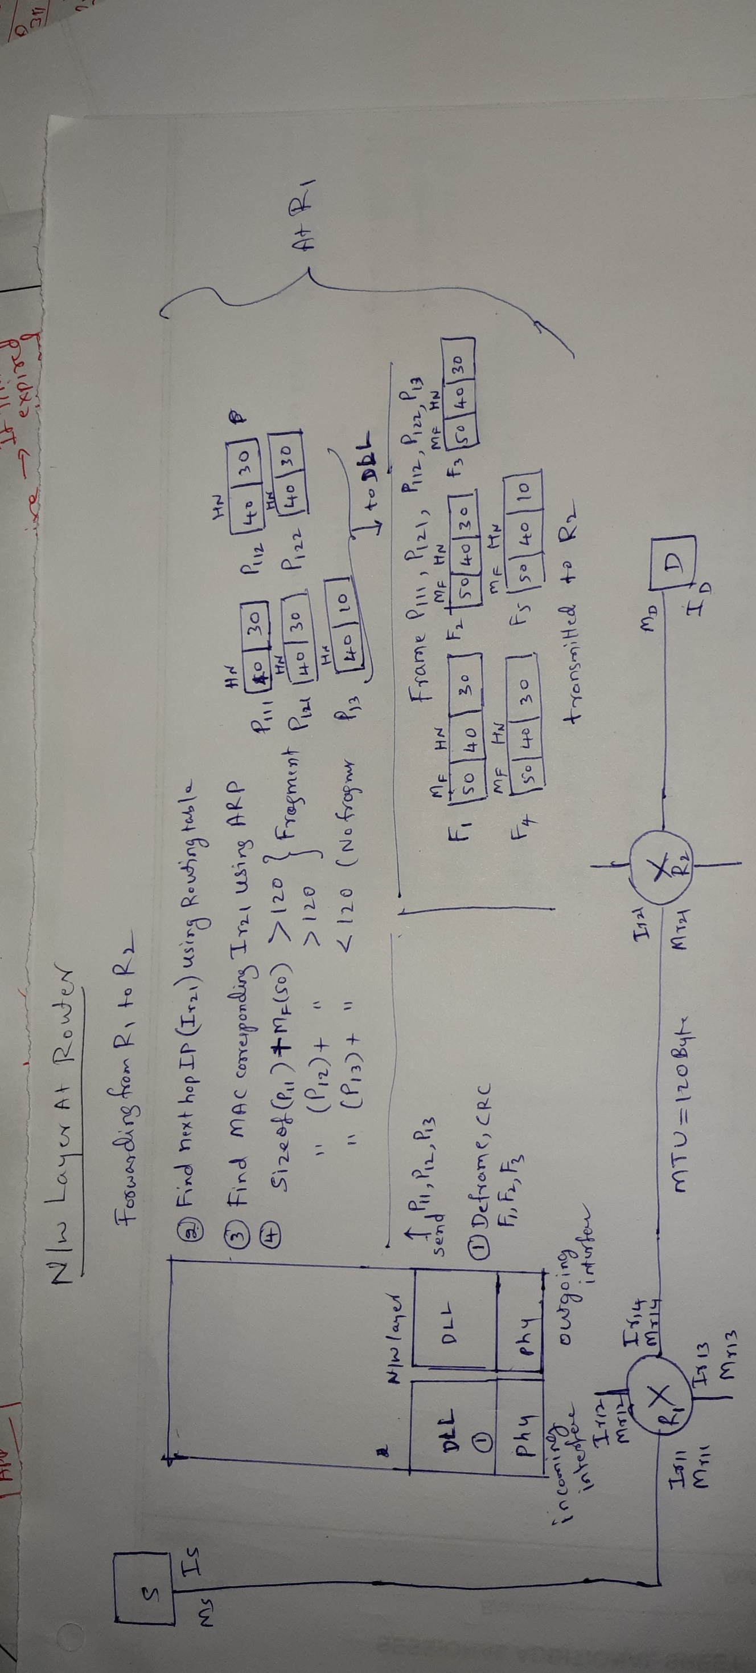
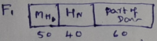
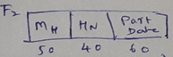
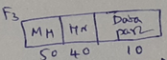
Network Layer at Router
Some fields in header also changes and
New Header checksum added

Slide 27
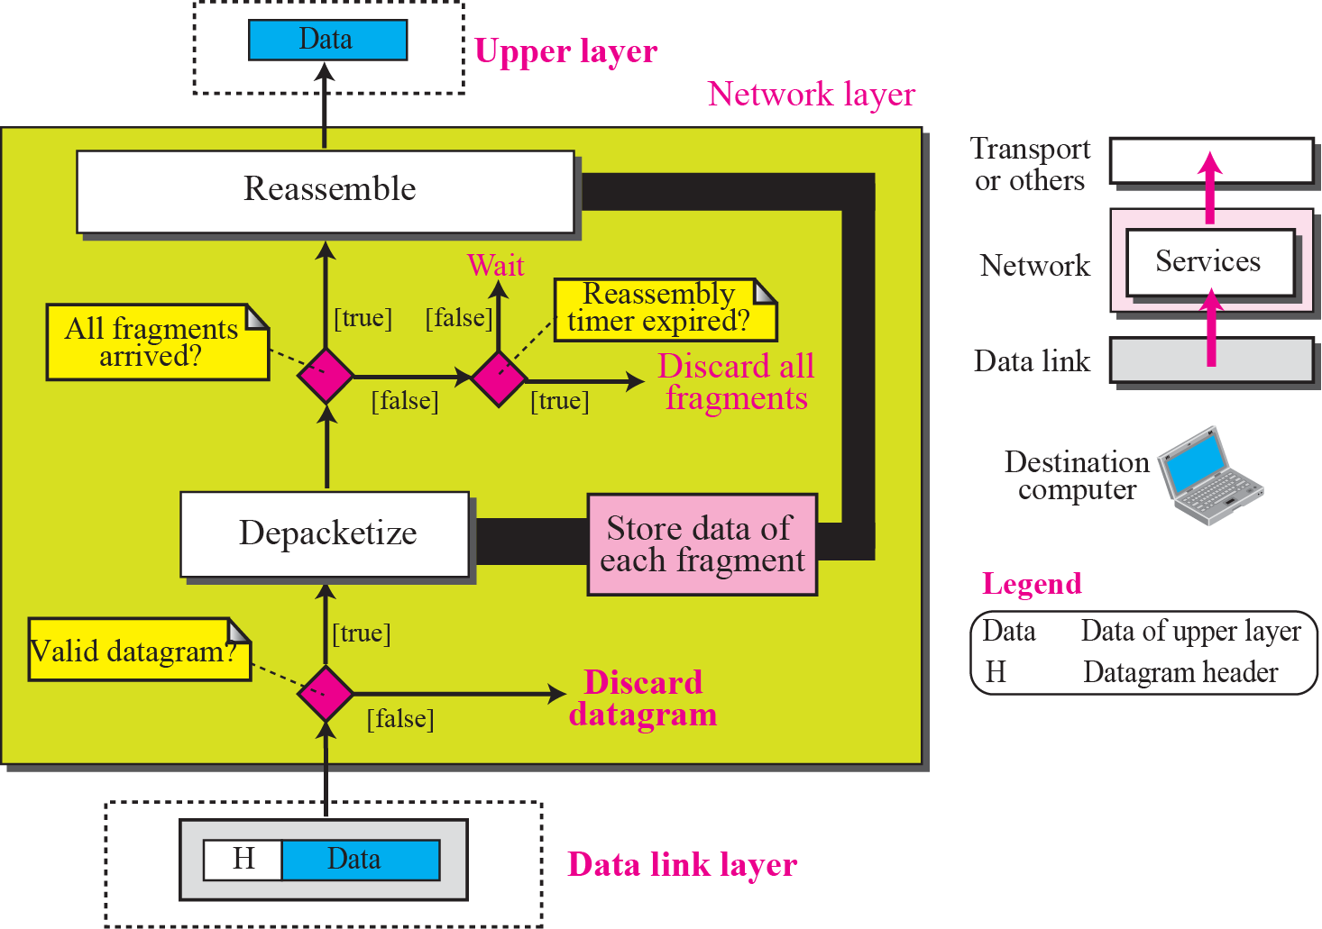
NETWORK LAYER SERVICES
Services Provided at the Destination Computer
Validates incoming Datagram.
Depacketize.
Store received fragment(reassembly Timer started).
If All Fragments not arrive before timer expiry then
Destroy received fragment.
Else
Reassemble fragments in Order
Time-exceeded ICMP message
Notes:
The destination computer needs to assemble the fragments before delivering the data to the destination. After validating each datagram, the data is extracted from
each fragment and stored. When all fragments have arrived, the data are reassembled and delivered to the upper layer. The network layer also sets a reassembly timer. If the
timer is expired, all data fragments are destroyed and an error message is sent that all the fragmented datagram need to be resent.
When the final destination does not receive all of the fragments in a set time, it discards the received fragments and sends a time-exceeded ICMP message to the original source.
https://erg.abdn.ac.uk/users/gorry/course/inet-pages/mtu.html
Example calculation of the segmentation performed by IP Routers
"Calculate the number of fragments which are sent when an IP datagram with payload of 3000 bytes is sent from a computer on a network A via two routers to a destination computer C. The MTU if network A is 4000 B. The MTU of network B is 508 B and for network C the MTU is 1500 B. Ensure that your answer specifies the number and size the of the IP datagrams sent on each of the LANs."
On First LAN
Total size of initial PDU = 3000 + 20 B (PCI) = 3020 B.
Network A: MTU 4000 B > 3020 B - therefore one packet is sent.
(packet sent with offset=0, more=FALSE)
On Second LAN
Network B: MTU 508 B < 3020 B - therefore fragmentation is required.
IP fragment payload size = 508- 20 B = 488 B. (Note this is aligned to an 8-byte boundary)
Total number of packets sent via network B = round(3000/488) = 7 packets.
First six packets of size 508 B, each with 488B of IP packet payload
The last packet has 48 B of data, and therefore of size 20 B + 72 B=92 B.
(all packets except first sent with offset>0,)
(packets 1-6 have more=TRUE, last packet has more=FALSE)
(This last fragment does not need to have a length that is divisible by 8).
On Final LAN
Fragments are not reassembled by a router - i.e. at router C.
Router C therefore receives 7 packets, 6 of size 508 B, 1 of size 92 B.
Network C: MTU 1500 B > 508 B - No further fragmentation is therefore needed.
i.e. There are 7 packets, as in network C, 6 of size 508 B and one of size 92 B.

Slide 28
Network Layer at Destination Computer
4. Reassembly:
Unique Sequence Number & Fragment offset helps n rearranging
Notes:
Network Layer at Destination Computer
Unique Sequence Number & Fragment offset helps n rearranging

Slide 29
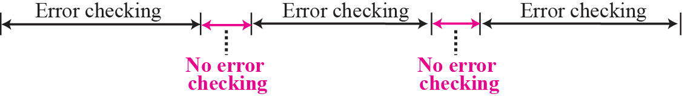
NETWORK LAYER SERVICES
OTHER SERVICES
–Error control : A mechanism for detecting corrupted, lost, or duplicate Datagrams.
Since a hop-to-hop error control (CRC)is already implemented at the data link layer, why do we need error control at the network layer?
The data link layer can miss any error that occurs when the datagram is being processed by the router.
To keep Network layer processing fast, Network Layer do not implement rigorous error checking.
However, N/W layer header checksum is used – to prevent packet being delivered to wrong destination
The network layer at the Internet does not directly provide error control, the Internet uses another protocol- ICMP(Internet Message Control Protocol) to report error situation to Sender
Notes:
In other words, if a hop-to-hop error control
is already implemented at the data link layer, why do we need error control at the network layer? Although hop-to-hop error control(CRC, Automatic Repeat Request (ARQ).) may protect a datagram to some extent, it does not provide full protection. Figure 4.16 shows that there are some areas in the path of the datagram that some errors may occur, but never checked; the error control at the data link layer can miss any error that occurs when the datagram is being processed by the router.
Another rationale for omitting the error checking at this layer can be related to fragmentation. Since the data is possibly fragmented at some routers and part of the network layer may be changed because of fragmentation, if we use error control, it must be checked at each router. This makes processing very inefficient at Routers and introduce more delay.
The designers of the network layer, however, have added a checksum field for header (see Chapter 7) to the datagram to control any corruption in the header, but not the whole
datagram. This checksum may prevent any changes or corruptions in the header of the datagram between two hops and from end to end. For example, it prevents the delivery of the datagram to a wrong destination if the destination address has been corrupted. However, since the header may be changed in each router, the checksum needs to be calculated at the source and recalculated at each router.

Slide 30
NETWORK LAYER SERVICES
Flow control
Regulates the amount of data a source can send without overwhelming the receiver.
–The network layer in the Internet, however, does not directly provide any flow control.
The datagrams are sent by the sender when they are ready without any attention to the readiness of the receiver.
– Flow control responsibility is given to the upper layer protocols (Transport layer) which use N/W layer protocol.
Notes:
– Since there is no error control in this layer, the job of the N/W layer is simple , rare possibilities of overwhelming the receiver

Slide 31
NETWORK LAYER SERVICES
Congestion control
Congestion in the network layer is a situation in which too many datagrams are present in an area of the Internet.
–Congestion in a connectionless network can also be implemented using a choke
Packet.
The network layer uses an auxiliary protocol, ICMP to inform Sender to slow down .
– Another way is to rank packets based on importance.
In a connection-oriented network
One method simply creates an extra virtual circuit.
A better solution is advanced negotiation during the setup phase.
Notes:
Congestion may occur if the number of datagrams sent by source computers
are beyond the capacity of the network or routers. In this situation, some routers may
drop some of the datagrams. However, as more datagrams are dropped, the situation
may become worse because, due to the error control mechanism at the upper layers, the
sender may send duplicates of the lost packets. If the congestion continues, sometimes
a situation may reach a point that collapses the system and no datagram is delivered.

Slide 32
NETWORK LAYER SERVICES
Other services are – Routing , QoS (upper layer) and Security
Notes:
Security was not a concern when the Internet was originally designed because it was used by a
small number of users at the universities to do research activities; other people had no
access to the Internet. The network layer was designed with no security provision.
Today, however, security is a big concern.

Slide 33
END

Slide 35
NETWORK LAYER SERVICES
Logical Addressing
–The network layer provides end-to-end communication.
– Each system in the network needs universal identification system(Logical Address/
Network Layer Address).
– IPv4 is the addressing scheme used( 32 bit address)
– New one is IPv6 addressing scheme

Slide 36
NETWORK LAYER SERVICES
Logical Addressing
–The network layer provides end-to-end communication.
– Each system in the network needs universal identification system(Logical Address/
Network Layer Address).
– IPv4 is the addressing scheme used( 32 bit address)
– New one is IPv6 addressing scheme

